Slide 1

Internet Sales Analysis: Driving Growth
A comprehensive business intelligence solution combining SQL-based data warehousing with interactive dashboard visualizations to analyze internet sales performance, customer behavior, and product trends.

Slide 2

Project Overview: Online Bicycle & Parts Retailer
Global Reach
3 Years of Data
Online bicycle & Parts and accessories retailer operating globally across multiple continents.
Dataset covers sales from 2019–2021, providing a robust historical view.
Key Insights
Analysis focuses on sales performance, customer behavior, and product trends.

Slide 3

Dataset Summary: Over 50,000 Rows
Our dataset comprises over 50,000 rows, structured across four key tables:
Fact_InternetSales: Product, Customer, Order Date, Sales Amount.
DIM_Products: Product name, category, color, size.
DIM_Customers: Demographic and geographic details.
DIM_Calendar: Year, Month, Quarter for time intelligence.

Slide 4
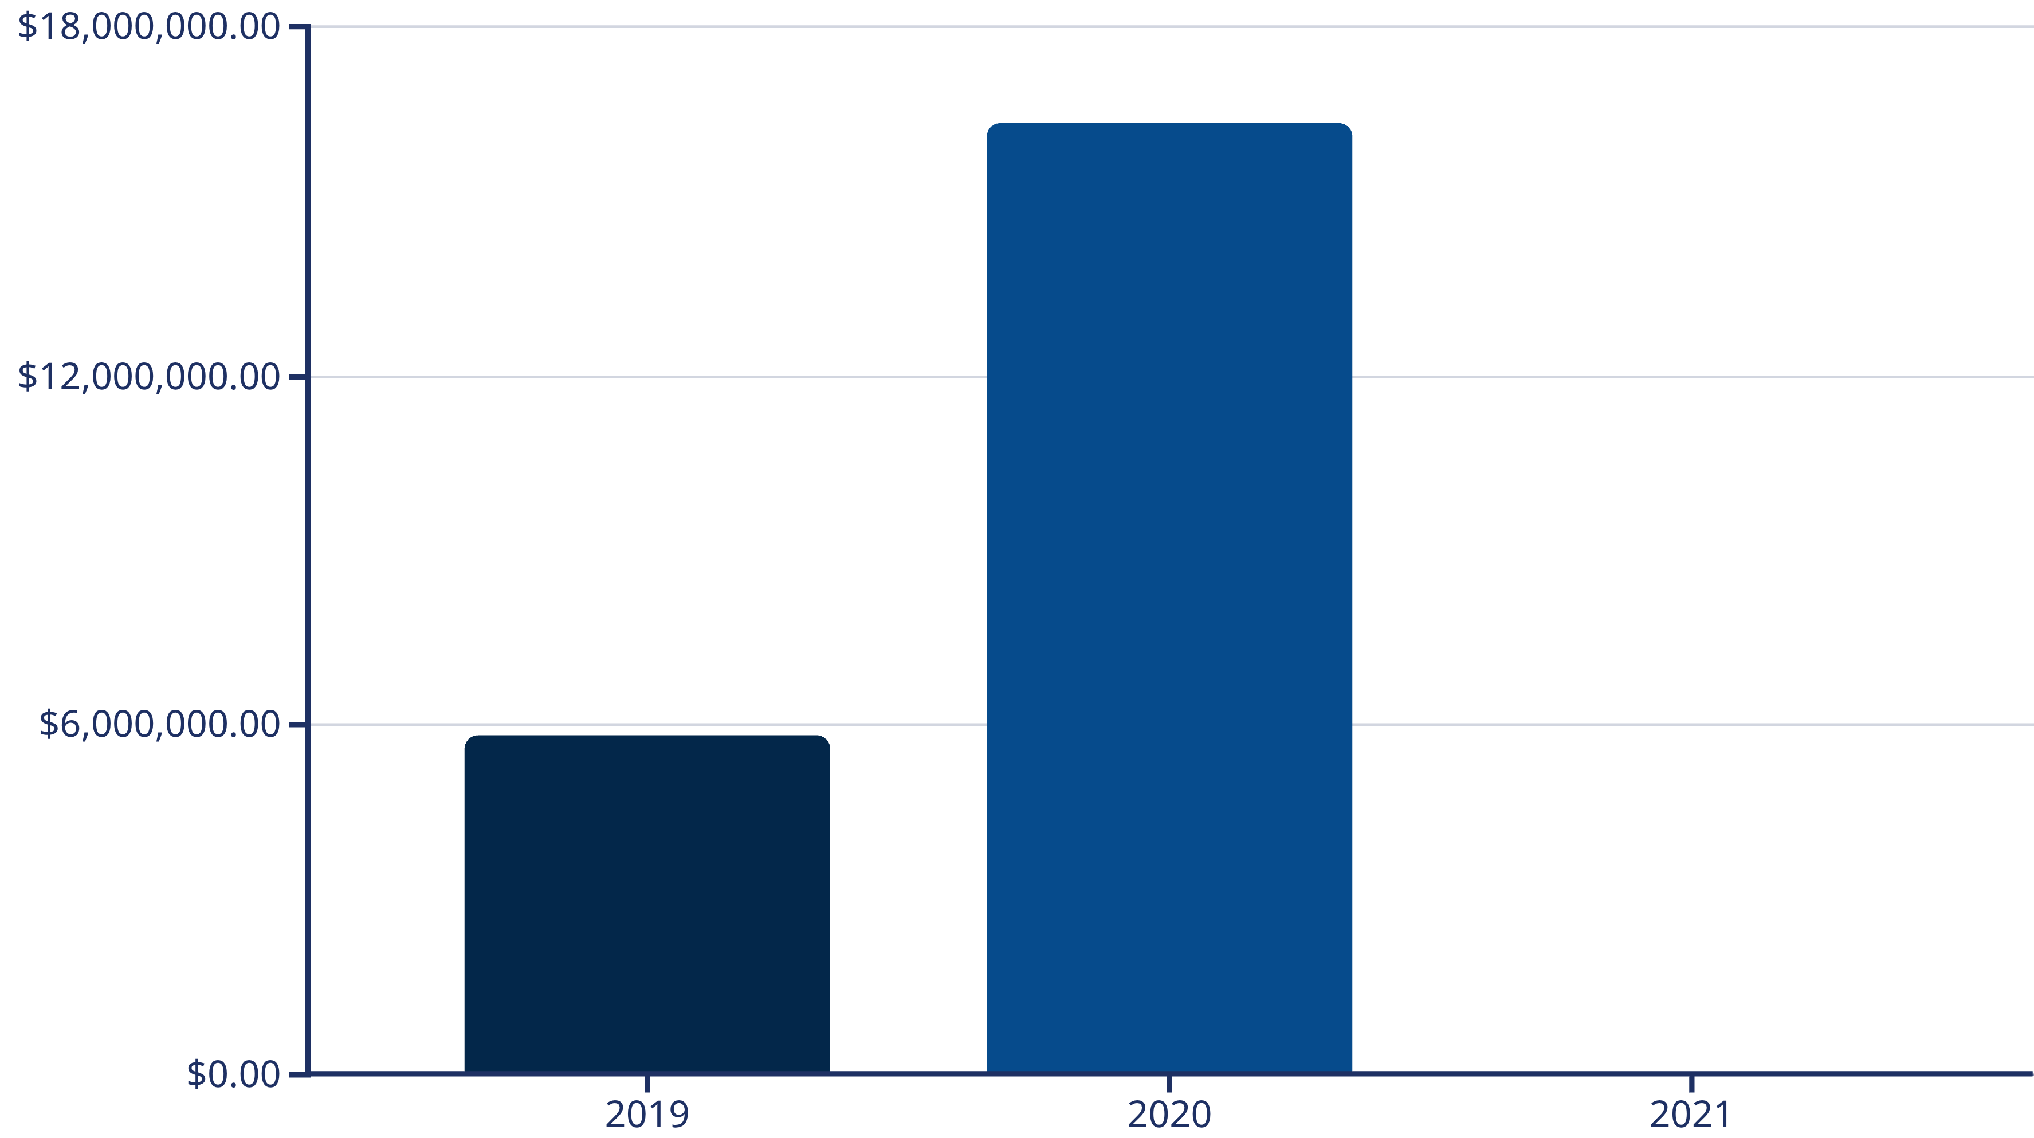
Annual Sales Performance (2019-2021)
Total Sales by Years:
2019: $5,839,631
2020: $16,351,550
2021: $45,694
Sales peaked significantly in 2020, indicating strong growth, followed by a sharp decline in 2021.
This trend warrants further investigation.

Slide 5
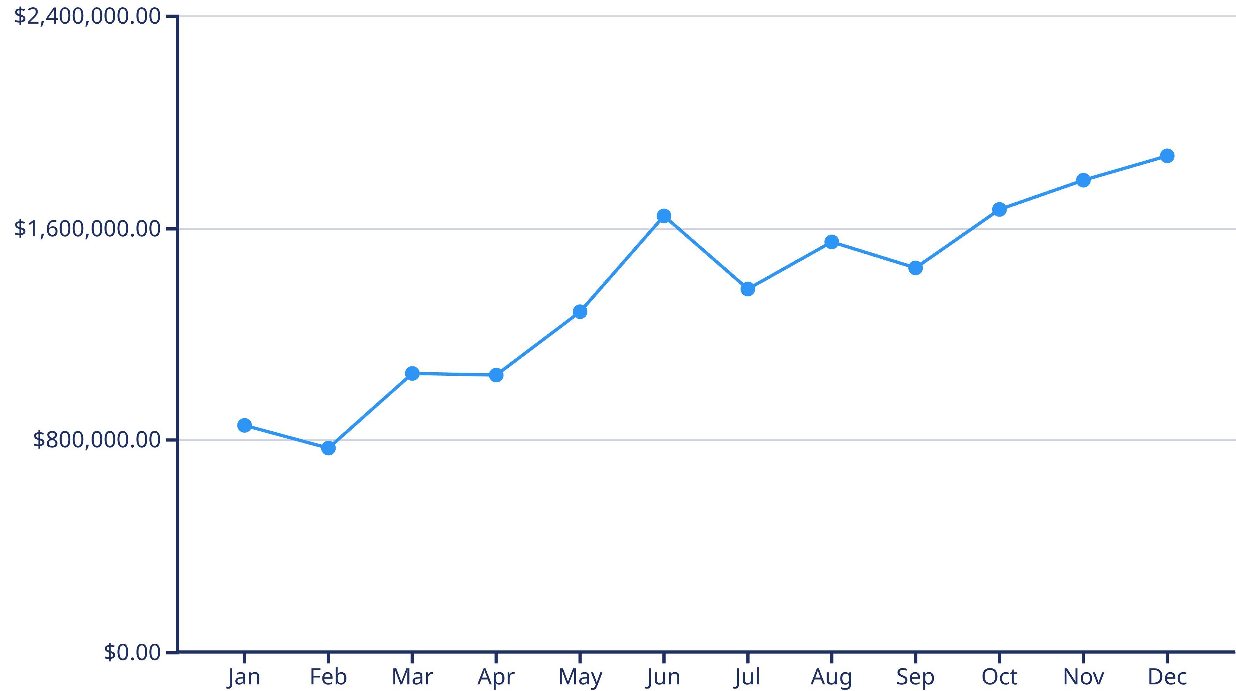
Monthly Sales Trend for 2020
2020 showed a consistent upward trend in sales, with significant peaks towards the end of the year,
highlighting strong seasonal demand.

Slide 6
Top 5 Products by Revenue
1
2
3
Mountain-200 Black, 46
Mountain-200 Black, 42
Mountain-200 Silver, 38
$1.37M
$1.36M
$1.34M
4
5
Mountain-200 Silver, 46
Mountain-200 Black, 38
$1.30M
$1.29M

Slide 7
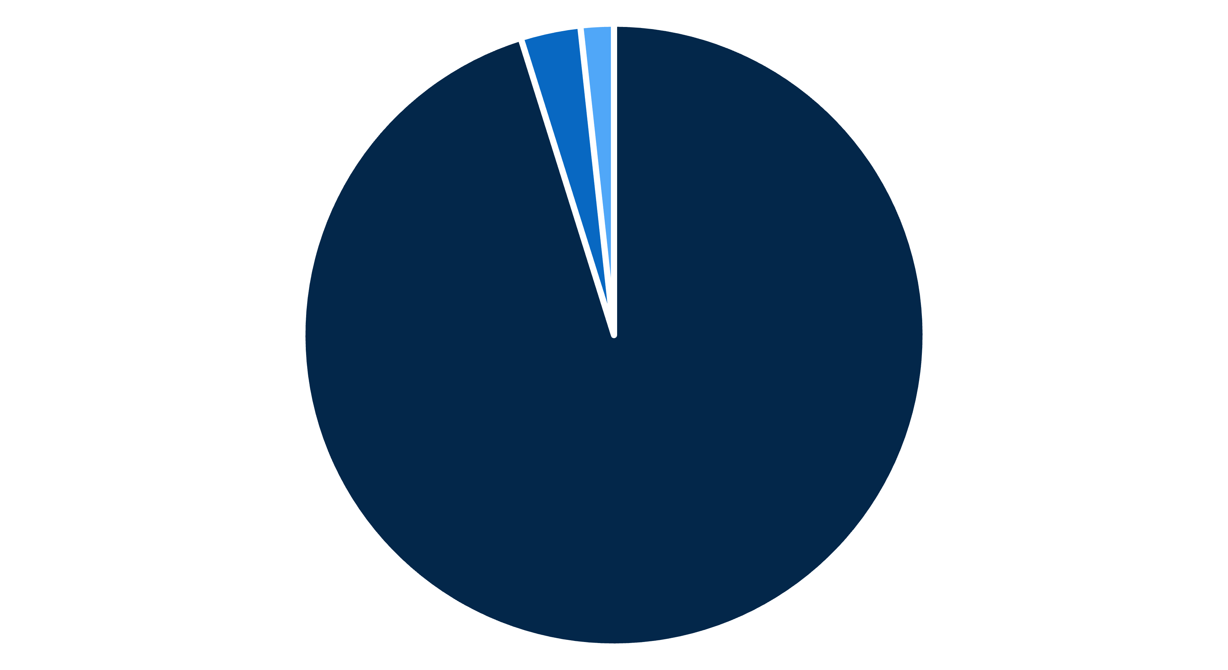
Product Category Sales Breakdown
Product Category Sales:
Bikes: $21,199,197.9
Accessories: $693,339.37
Clothing: $384,785.61
Bikes
Accessories
Clothing
Bikes dominate sales, accounting for over 90% of total revenue.
Accessories and Clothing contribute smaller, but significant, portions.

Slide 8
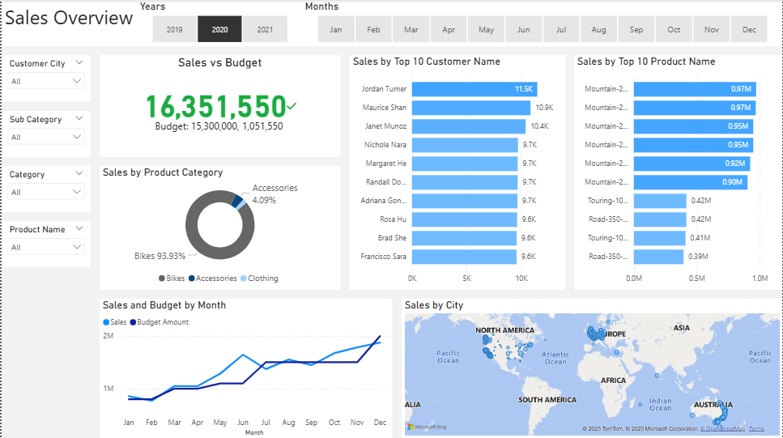
Power BI Dashboards: Visualizing Insights
Our interactive Power BI dashboards provide a dynamic view of sales performance, customer behavior, and product trends. Filters allow for detailed exploration by year, month, city, category, and product.

Slide 9

Key Business Recommendations
Invest in High-Performing Products
1
Expand stock and promotions for best-sellers like Mountain-200 series.
Enhance Customer Retention
2
Implement loyalty programs and personalized communication for top customers.
Optimize Inventory
3
Align stock levels with monthly sales trends to prevent overstocking or shortages.
Targeted Marketing
4
Strengthen efforts in high-revenue regions and launch campaigns for weaker markets.

Slide 10




Strategic Growth Opportunities
Expand Product Offerings
Customer Segmentation
Introduce new products in categories with consistent sales growth.
Utilize data for targeted marketing and higher conversion rates.
Innovation & Adaptability
Operational Efficiency
Continuously evolve product lines and marketing strategies.
Streamline processes based on data insights for better profitability.

Slide 11


